Slide 1
2 Corinthians 13:5-6
⁵ Examine yourselves, to see whether you are in the faith. Test yourselves. Or do you not realize this about yourselves, that Jesus Christ is in you?— unless indeed you fail to meet the test! ⁶ I hope you will find out that we have not failed the test.

Slide 3
2 Corinthians 10:2
² I beg of you that when I am present I may not have to show boldness with such confidence as I count on showing against some who suspect us of walking according to the flesh.

Slide 5
2 Corinthians 10:3-6

Slide 7
1 Corinthians 1:22-24
²¹ For since, in the wisdom of God, the world did not know God through wisdom, it pleased God through the folly of what we preach to save those who believe. ²² For Jews demand signs and Greeks seek wisdom, ²³ but we preach Christ crucified, a stumbling block to Jews and folly to Gentiles, ²⁴ but to those who are called, both Jews and Greeks, Christ the power of God and the wisdom of God.

Slide 9
1 Corinthians 2:1-5
And I, when I came to you, brothers, did not come proclaiming to you the testimony of God with lofty speech or wisdom. ² For I decided to know nothing among you except Jesus Christ and him crucified. ³ And I was with you in weakness and in fear and much trembling, ⁴ and my speech and my message were not in plausible words of wisdom, but in demonstration of the Spirit and of power, ⁵ that your faith might not rest in the wisdom of men but in the power of God.

Slide 11
2 Corinthians 4:1-2
Therefore, having this ministry by the mercy of God, we do not lose heart. ² But we have renounced disgraceful, underhanded ways. We refuse to practice cunning or to tamper with God's word, but by the open statement of the truth we would commend ourselves to everyone's conscience in the sight of God.

Slide 13
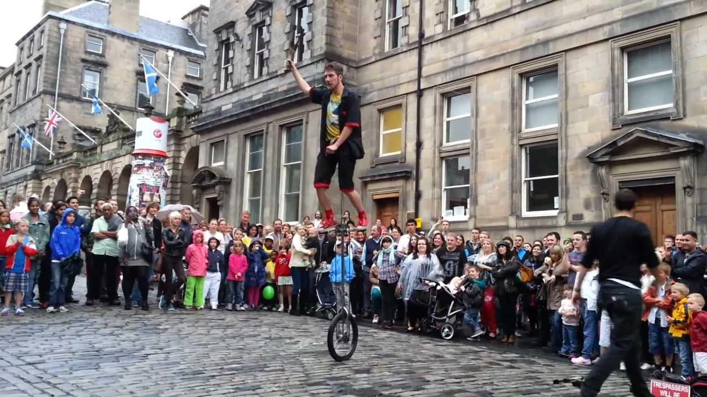

Slide 15
Discussion Questions:
Christians must be discerning, especially in judging Christian ministry. Do you agree? Why/why not?
What criteria for judging ‘true Christian ministry’ have you used in the past? How has today’s passage changed or affirmed this?

