Slide 3
3:1 - ‘Or do we need, as some do, letters of recommendation to you, or from you?’
10:2 - ‘some who suspect us of walking according to the flesh’
10:12 - ‘Not that we dare to classify or compare ourselves with some of those who are commending themselves’
2:17 - ‘For we are not, like so many, peddlers of God’s word…’

Slide 5
2 Corinthians 11:13-15

Slide 7
False Teachers vs
Paul (11:20)

Slide 8
False Teachers
Enslaved
Paul
Became a slave for them (4:5)
VS

Slide 9
False Teachers
Enslaved
Took advantage
Paul
Became a slave for them (4:5)
Refused $$$ (11:7-9)
VS

Slide 10
False Teachers
Enslaved
Took advantage
Put on airs
Paul
Became a slave for them (4:5)
Refused $$$ (11:7-9)
Meek and Gentle (10:1)
VS

Slide 11
False Teachers
Enslaved
Took advantage
Put on airs
Abusive
Paul
Became a slave for them (4:5)
Refused $$$ (11:7-9)
Meek and Gentle (10:1)
Patient, Kind, Loving (6:6)
VS

Slide 13
2 Corinthians 11:23-28

Slide 15
2 Corinthians 11:29

Slide 17
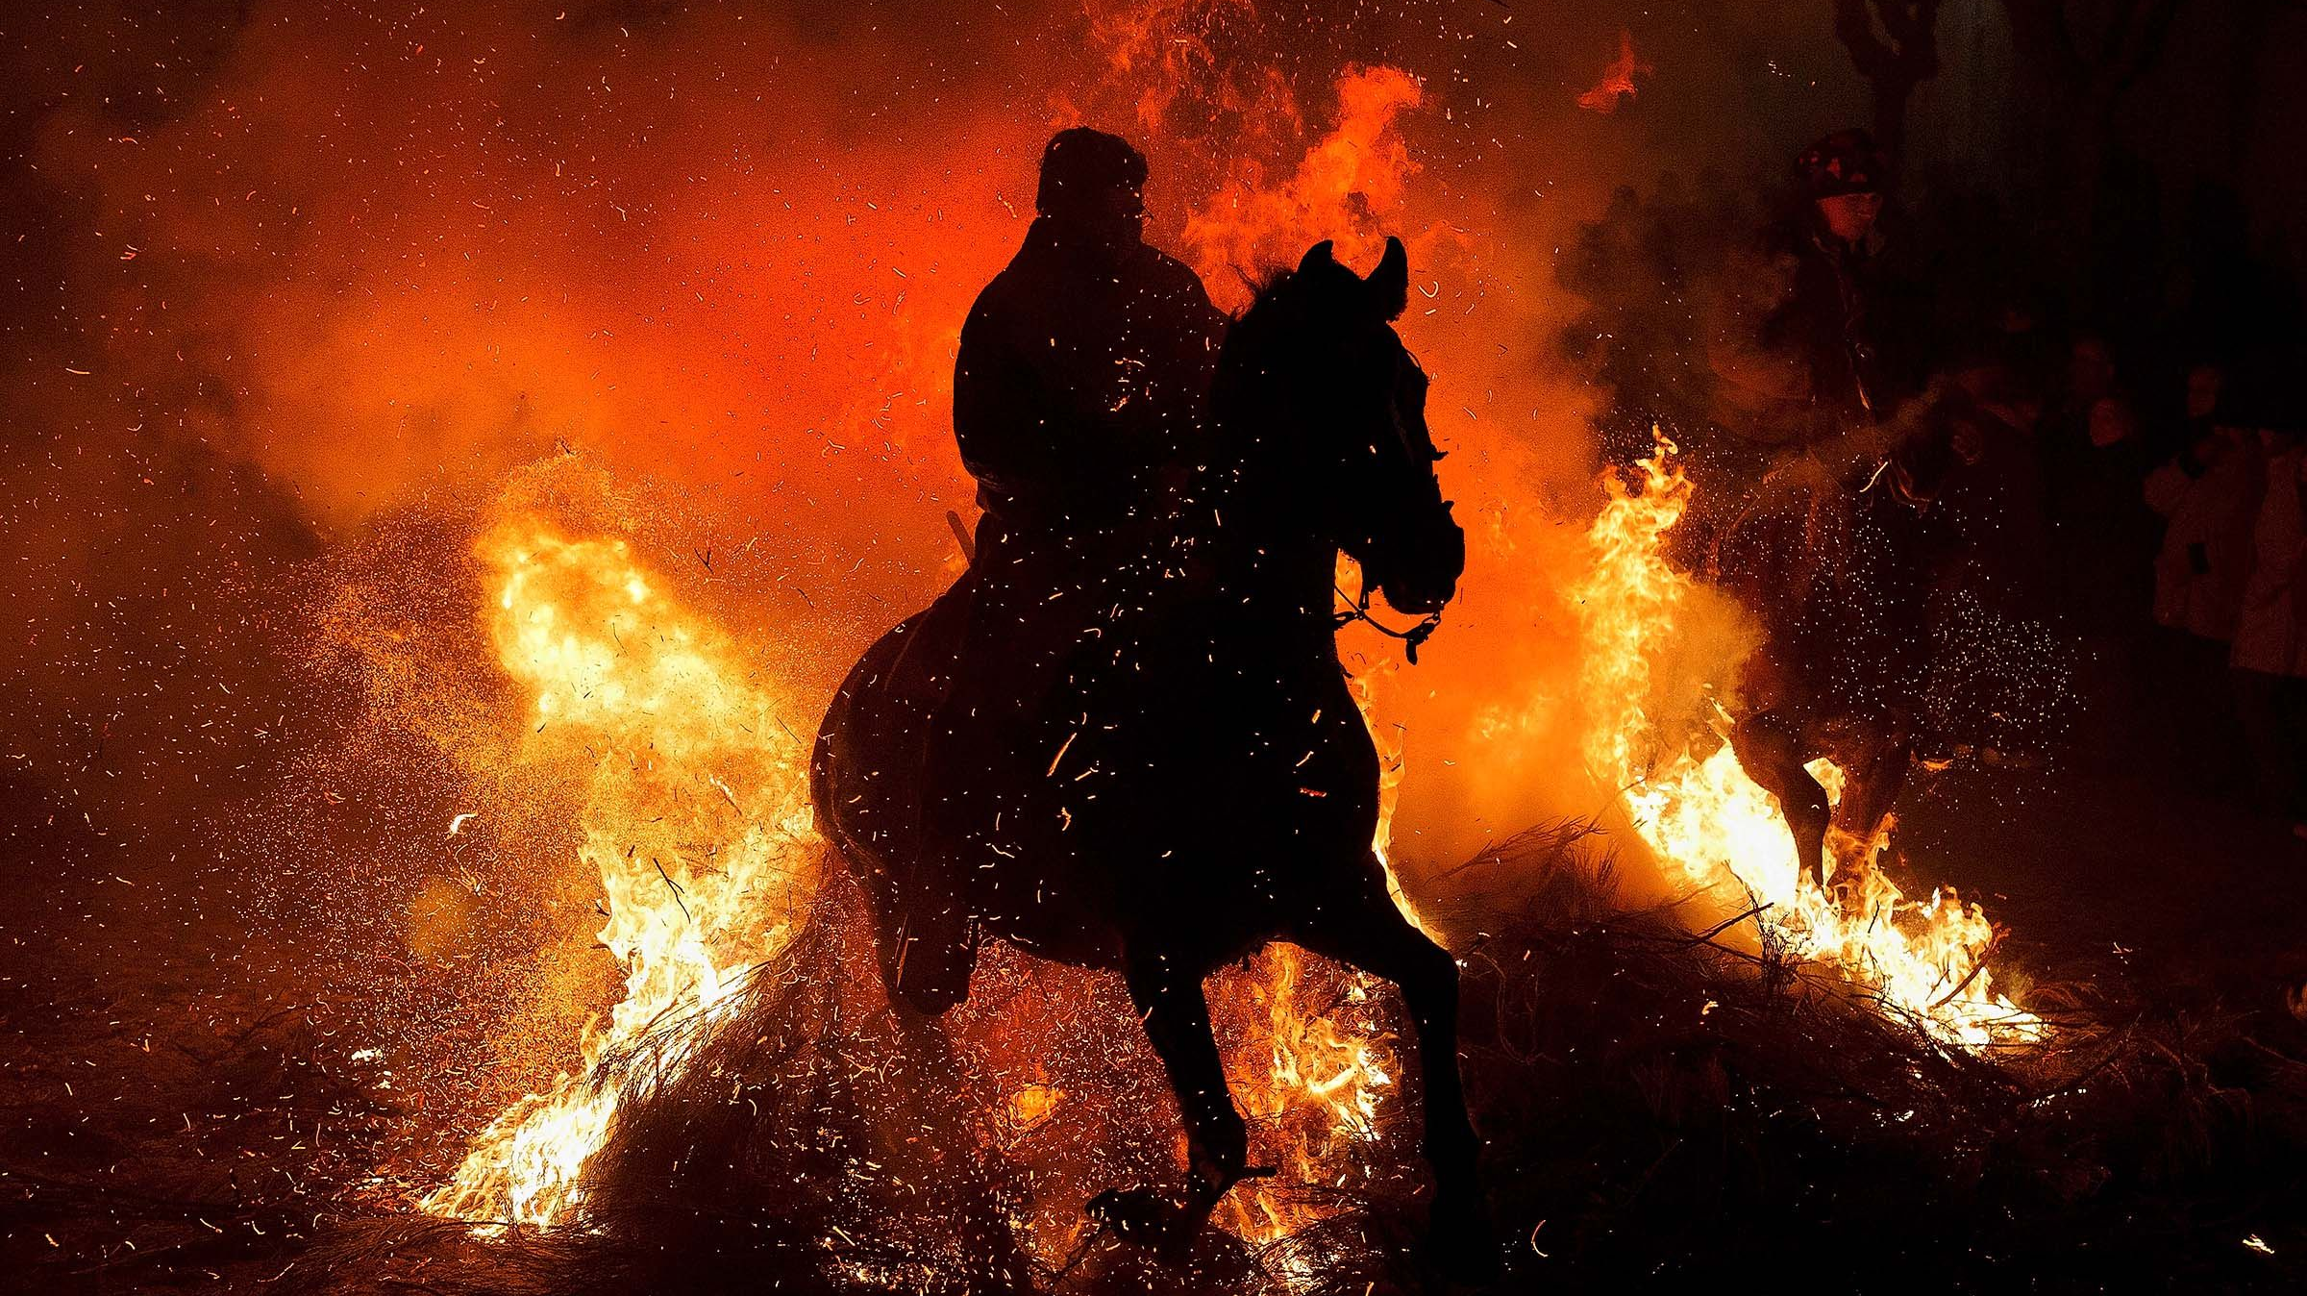

Slide 18
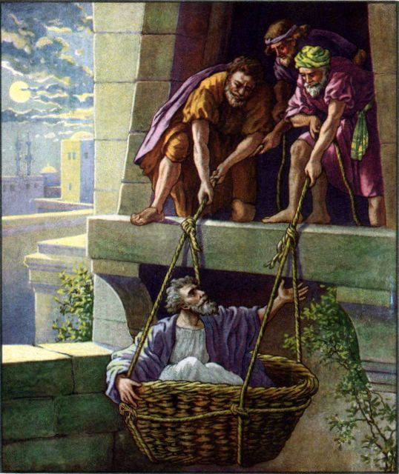

Slide 20
2 Corinthians 12:2-4

Slide 22
2 Corinthians 12:7

Slide 24
2 Corinthians 12:8-10

Slide 26
[27] But God chose what is foolish in the world to shame
the wise; God chose what is weak in the world to shame
the strong; [28] God chose what is low and despised
in the world, even things that are not, to bring to nothing
things that are, [29] so that no human being might boast
in the presence of God.
1 CORINTHIANS 1:27–29

Slide 28
