Slide 2
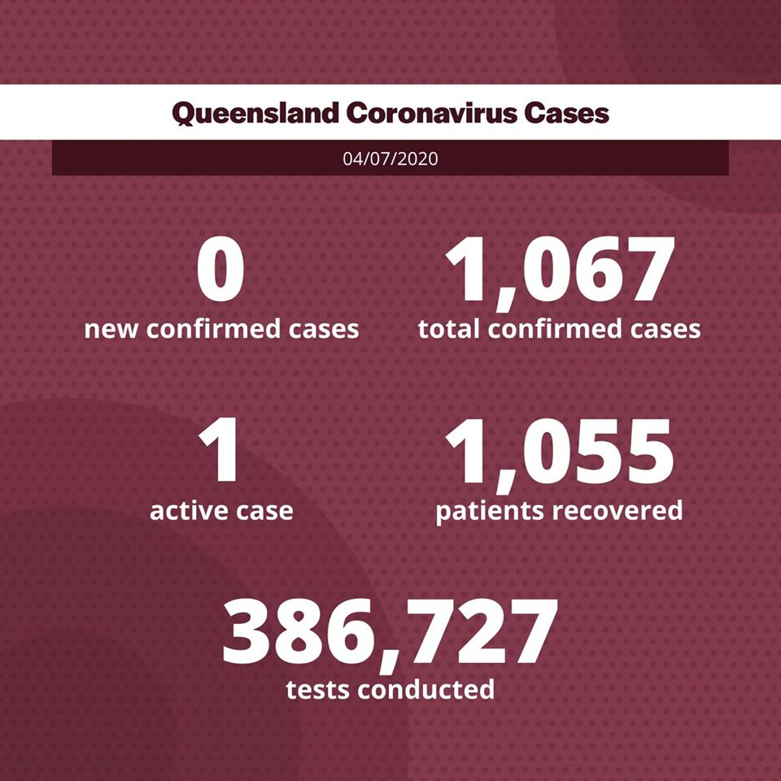

Slide 3
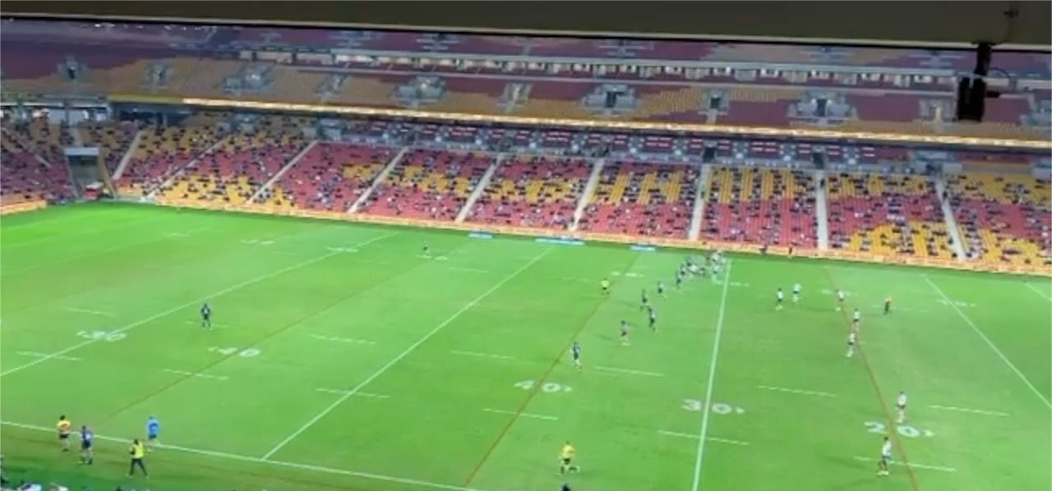

Slide 5
LAND
GREAT
NATION
BLESSING
Abraham
c. 1925BC

Slide 6
Abraham
c. 1925BC
Isaac
Jacob/ Israel
c. 1800BC

Slide 7
Reuben
Benjamin
Simeon
Joseph
Jacob/ Israel
Levi
Naphtali
Judah
Dan
Issachar
Asher
Zebulun
Gad

Slide 8
Ephraim
Reuben
Benjamin
Simeon
Levi
Manasseh
Joseph
Jacob/ Israel
Naphtali
Judah
Dan
Issachar
Asher
Zebulun
Gad

Slide 10
Joshua 1:1-2a

Slide 12
Hoshea =
‘Salvation/Deliverance’

Slide 13
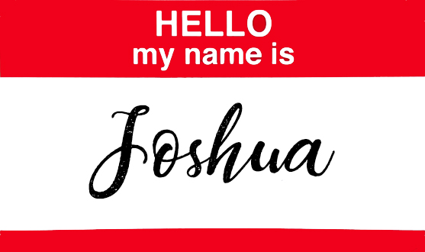
Joshua =
Yahweh saves

Slide 15
Joshua 1:2-3

Slide 17
Joshua 1:5

Slide 19
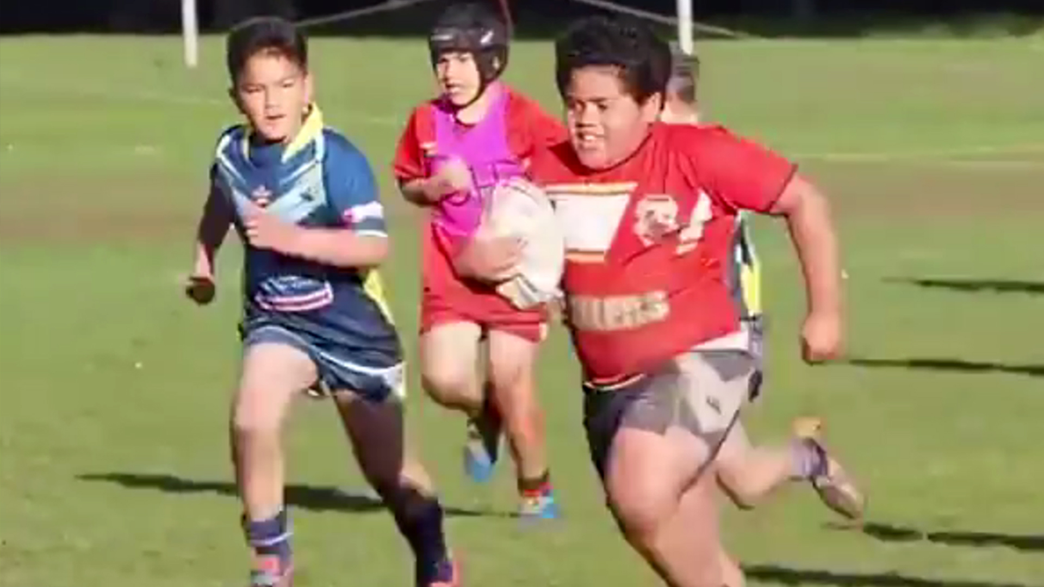

Slide 20
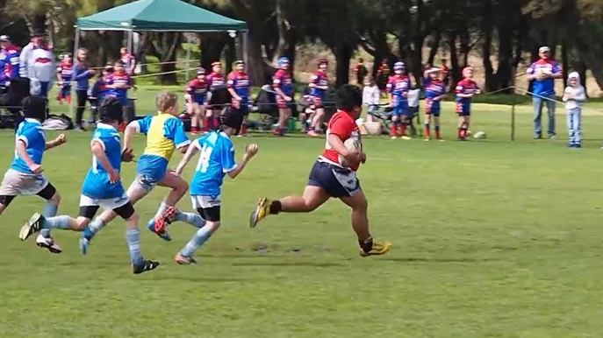
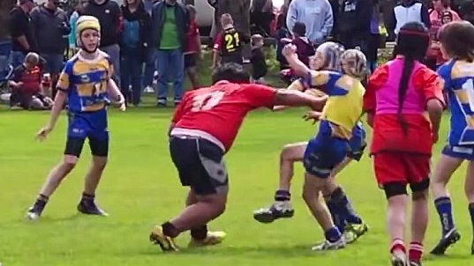
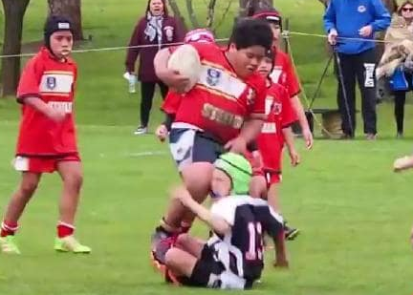
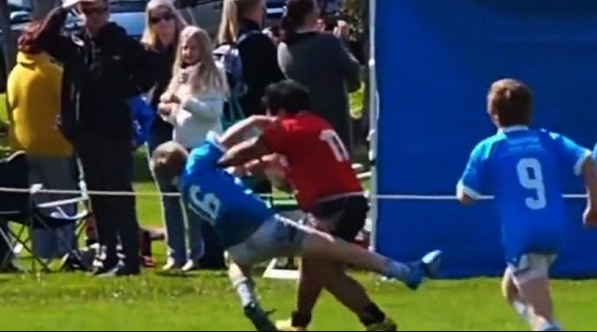
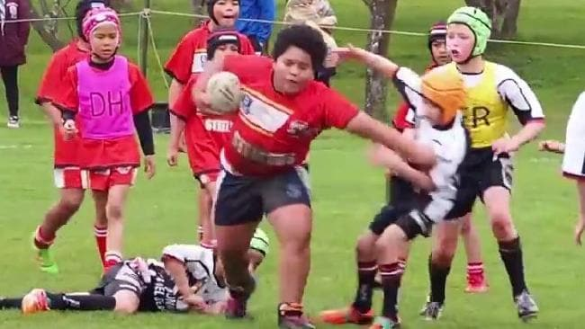

Slide 22
Joshua 1:6-9

Slide 26
Numbers 32:1-10

Slide 28
ESV: ‘Only may the LORD your God be with you…’
Literal: ‘Only may the LORD your God [will] be with you…’

Slide 30
Jesus, [who is] the founder and perfecter of our faith, who for the joy that was set before him endured the cross, despising the shame, and is seated at the right hand of the throne of God.
Hebrews 12:2

Slide 32
But he answered, “It is written, “‘Man shall not live by bread alone, but by every word that comes from the mouth of God.’”
Matthew 4:4

Slide 34
For all the promises of God find their Yes in him. That is why it is through him that we utter our Amen to God for his glory.
2 Corinthians 1:20

Slide 36
…And behold, I am with you always, to the end of the age.”
Matthew 28:20

