Slide 1
Joshua 21:43-45

Slide 2
Joshua’s Final Speeches
22: to the 2.5 Eastern Tribes
23: to the leaders of Israel
24: to all of Israel

Slide 4
Joshua’s Final Speeches
22: Loyalty and Unity
23-24: Loyalty and Service

Slide 6
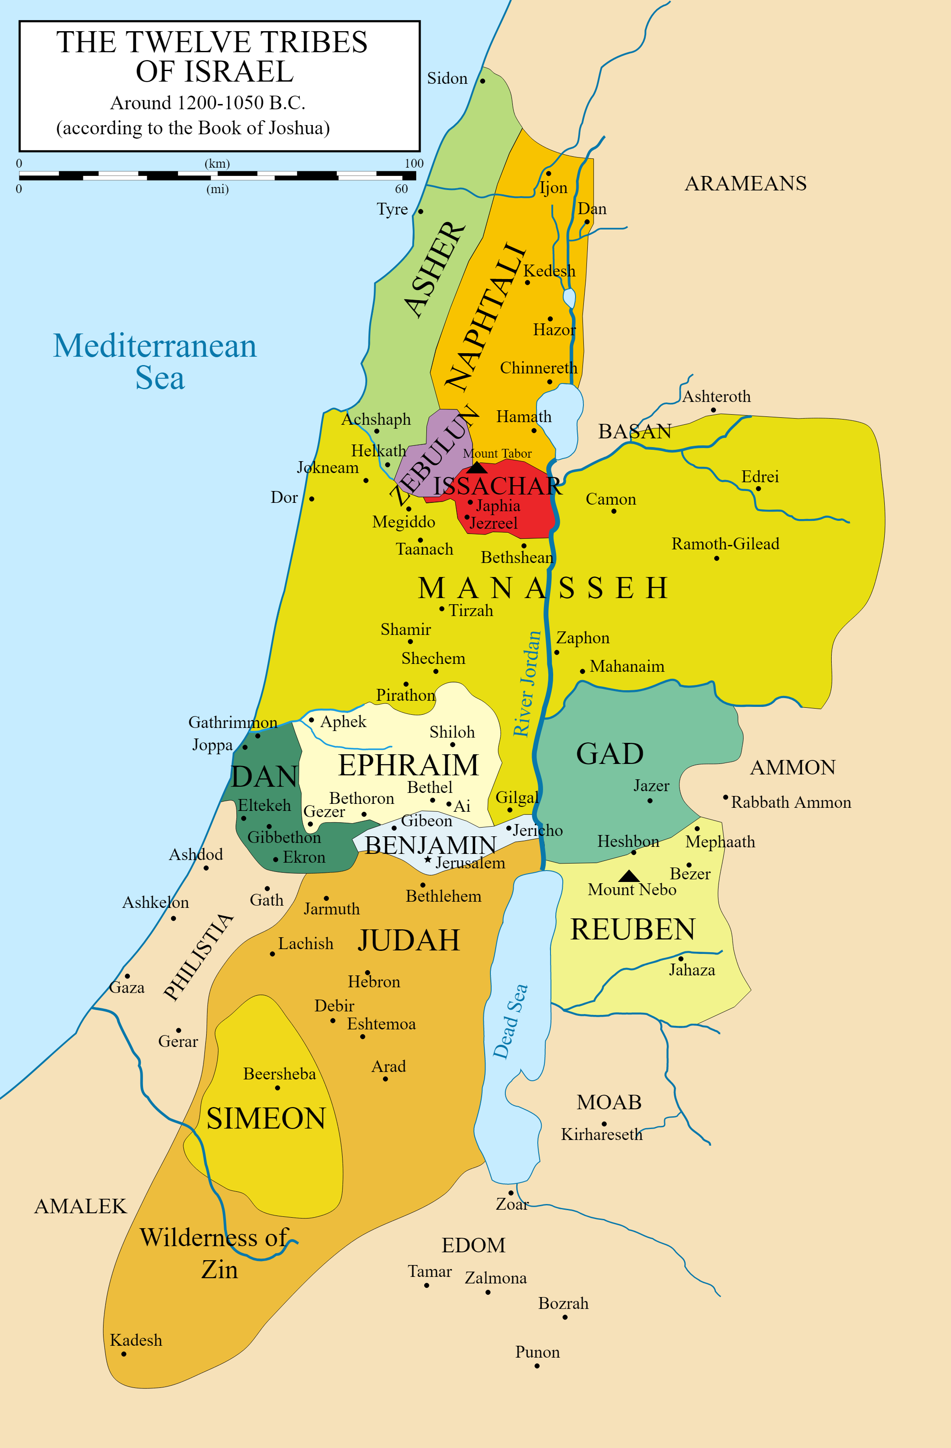
“EASTIES”
Land east of the Jordan
Already given by Moses

Slide 8
“WESTIES”
“Promised Land”
Land west of the Jordan
Given by Joshua

Slide 10
Joshua 22:5

Slide 12
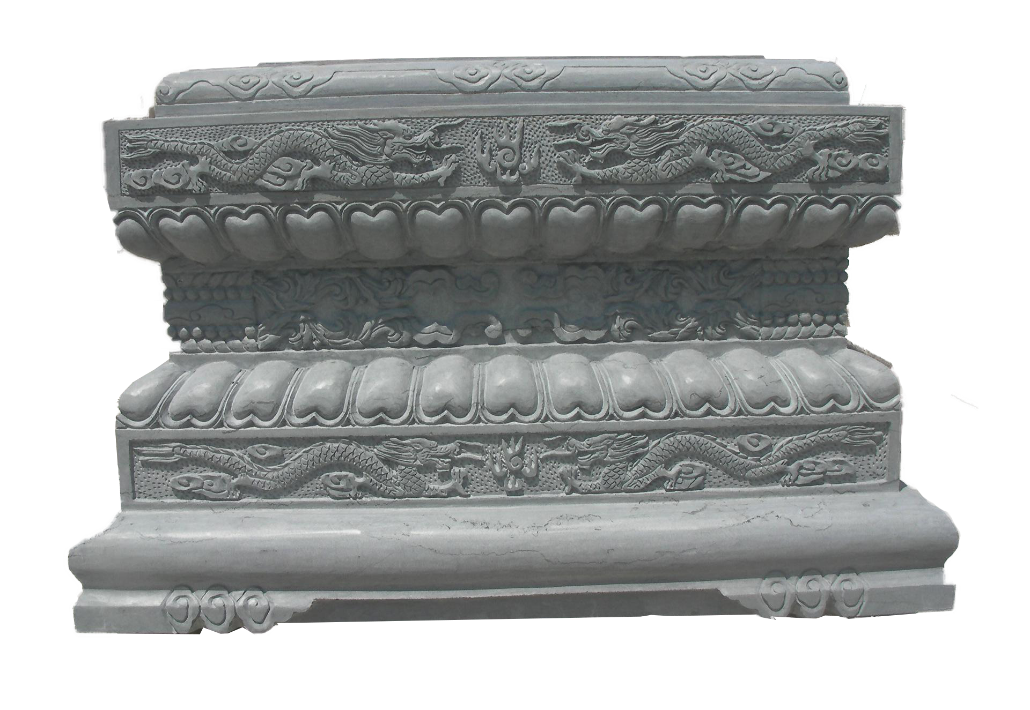
Altar of “Imposing Size”

Slide 14
Joshua 22:16b

Slide 16
Deuteronomy 12:1-2
¹ "These are the statutes and rules that you shall be careful to do in the land that the LORD, the God of your fathers, has given you to possess, all the days that you live on the earth. 2 You shall surely destroy all the places where the nations whom you shall dispossess served their gods, on the high mountains and on the hills and under every green tree.

Slide 17
Deuteronomy 12:3-4
³ You shall tear down their altars and dash in pieces their pillars and burn their Asherim with fire. You shall chop down the carved images of their gods and destroy their name out of that place. ⁴ You shall not worship the LORD your God in that way.

Slide 18
Deuteronomy 12:5-6
⁵ But you shall seek the place that the LORD your God will choose out of all your tribes to put his name and make his habitation there. There you shall go, ⁶ and there you shall bring your burnt offerings and your sacrifices, your tithes and the contribution that you present, your vow offerings, your freewill offerings, and the firstborn of your herd and of your flock.

Slide 19
Deuteronomy 12:13-14
¹³ Take care that you do not offer your burnt offerings at any place that you see, ¹⁴ but at the place that the LORD will choose in one of your tribes, there you shall offer your burnt offerings, and there you shall do all that I am commanding you.

Slide 21
Joshua 22:17-19

Slide 23
Joshua 22:20

Slide 27
Matthew 18:15-17
¹⁵ "If your brother sins against you, go and tell him his fault, between you and him alone. If he listens to you, you have gained your brother. ¹⁶ But if he does not listen, take one or two others along with you, that every charge may be established by the evidence of two or three witnesses. ¹⁷ If he refuses to listen to them, tell it to the church. And if he refuses to listen even to the church, let him be to you as a Gentile and a tax collector.

Slide 29
Joshua 22:24-29

Slide 31
Altar of WITNESS
WEST
EAST

Slide 32
Altar of WITNESS
WEST
EAST

Slide 34
Discussion Questions:
Consider how you have been thinking of Christian ‘unity’ in the past. What kind of unity came to mind?
Why can there not be true unity without shared loyalty to the Lord Jesus?
Have you confronted someone out of concern for their faith before? Why/why not?
How are you challenged to do so from today’s message? What scenarios can you think of where you might need to do so?

