Slide 1
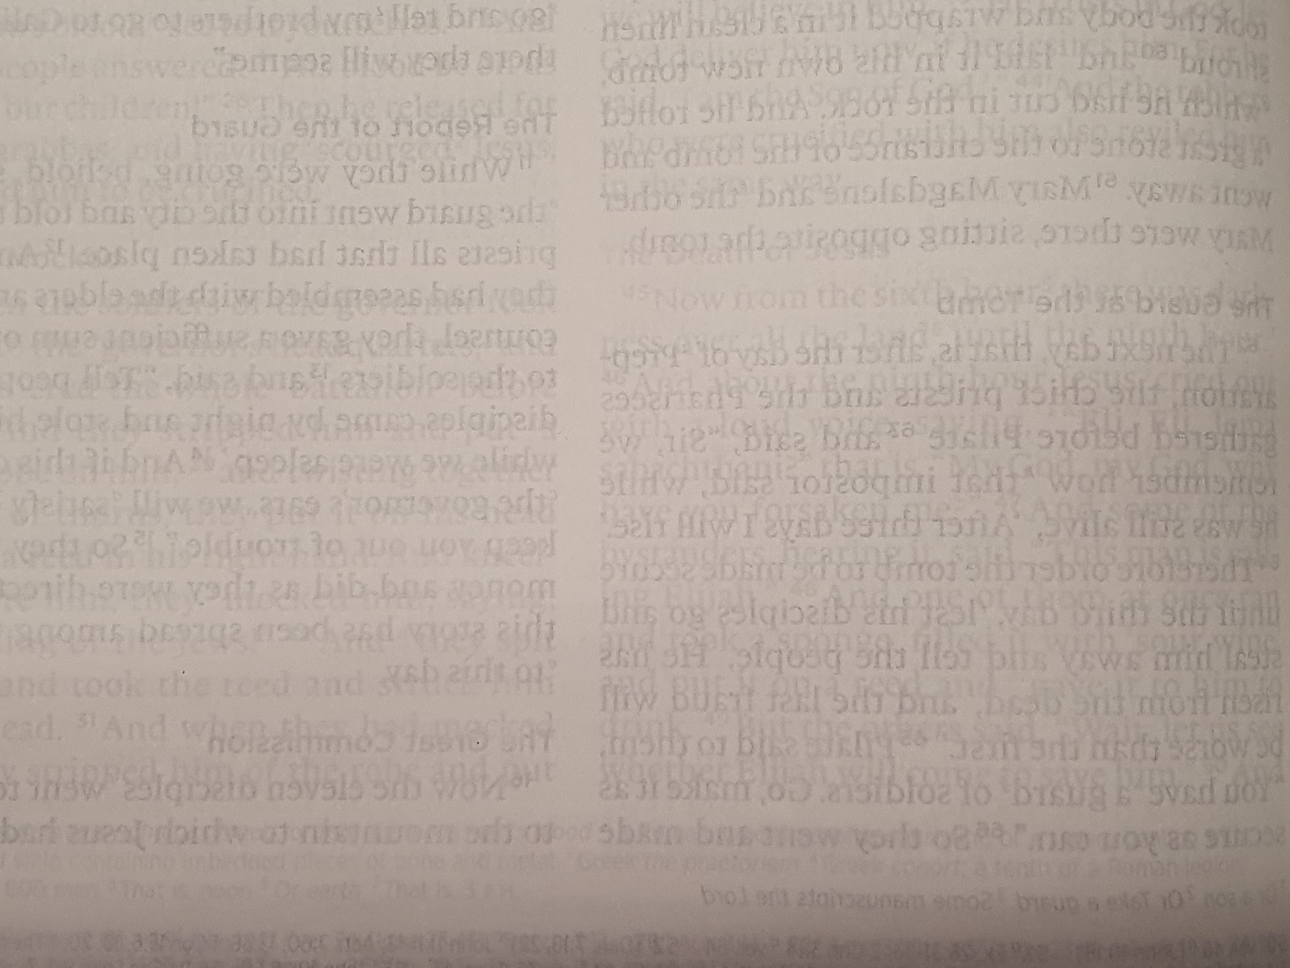
Joshua 23:3-5

Slide 2
Joshua 24:2-13

Slide 3
Joshua 23:6-11

Slide 4
Joshua 24:14-15

Slide 5
John 14:15
¹⁵ "If you love me, you will keep my commandments.

Slide 6
1 John 5:2-3
² By this we know that we love the children of God, when we love God and obey his commandments. ³ For this is the love of God, that we keep his commandments. And his commandments are not burdensome.

Slide 7
Joshua 24:2

Slide 8
Joshua 24:14-15

Slide 9
Joshua 23:7

Slide 10
Joshua 23:12

Slide 11
Joshua 23:14-16

Slide 12
Joshua 24:15

