Slide 1
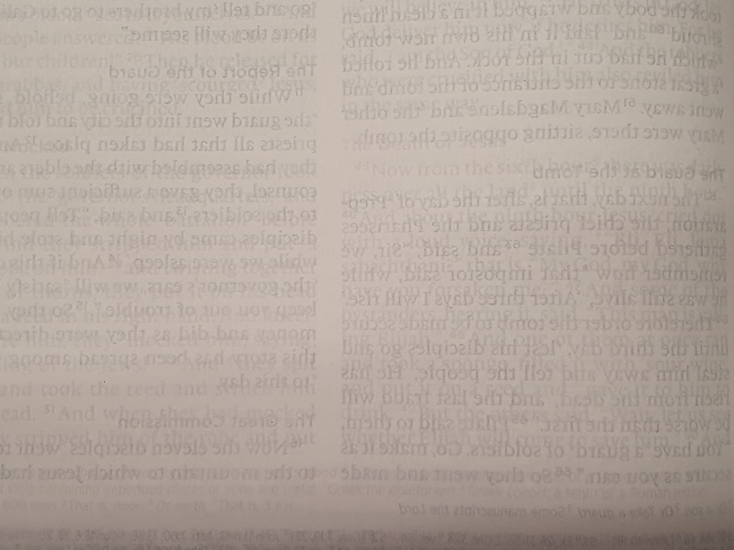
Luke 9:46-48

Slide 3
Luke 9:49-50

Slide 5
Luke 9:57

Slide 7
Luke 9:58

Slide 9
Luke 9:59

Slide 11
Luke 9:61

Slide 13
Luke 9:62

